Slide 1


Online Post System
Group members :
Usman AHMED (STD ID : 1422606)
HAIDER FARAZ (STD ID : 1369966)
SANA YOUSUF (STD ID : 1367624)
HAMAS ALI (STD ID : 1342491)

Slide 2
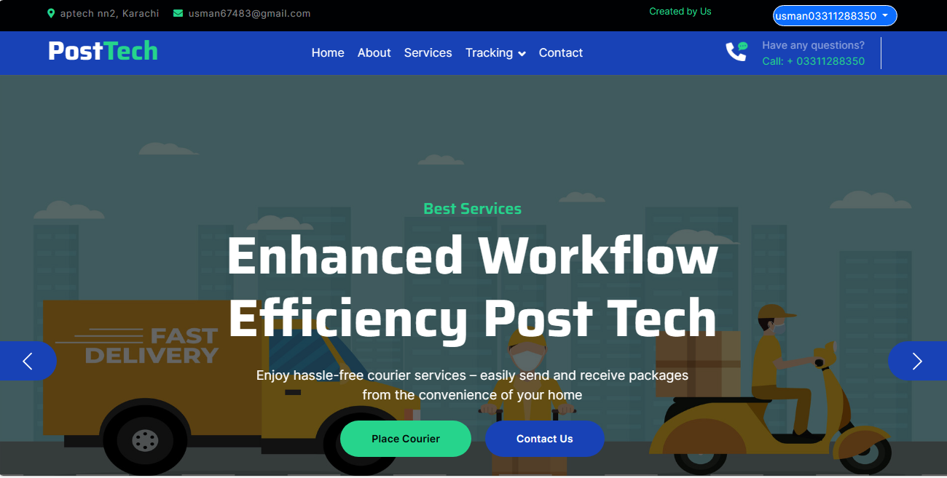
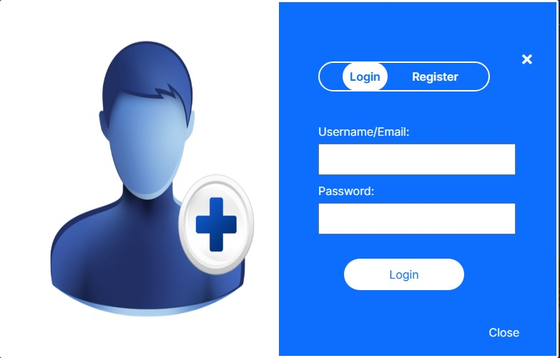
LOGIN / REGISTER
The authentication form facilitates three distinct logins for users, admins, and employees, allowing each to access their respective panels securely and efficiently.

Slide 3
USER FUNCTIONALITIES

Slide 4
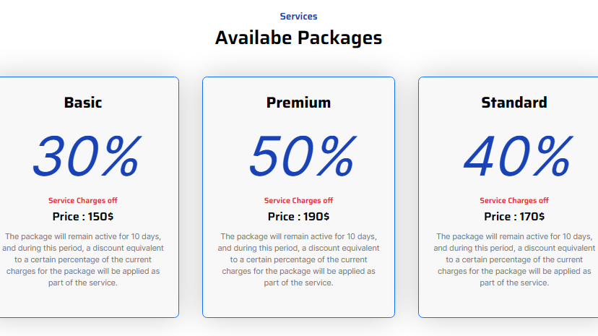
PACKAGE SERVICES
When purchasing the user package from here, the individual is eligible for a discount on courier charges.

Slide 5
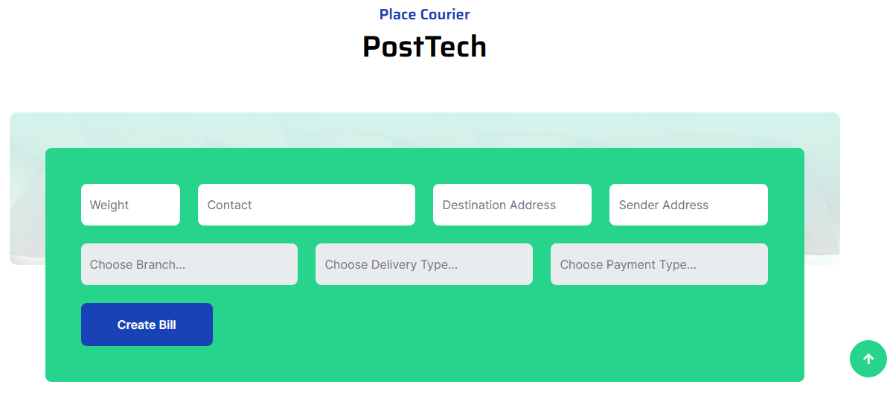

PLACE COURIER
There is a courier form where the user fills in their delivery details and places their courier/post from one location to another.

Slide 6
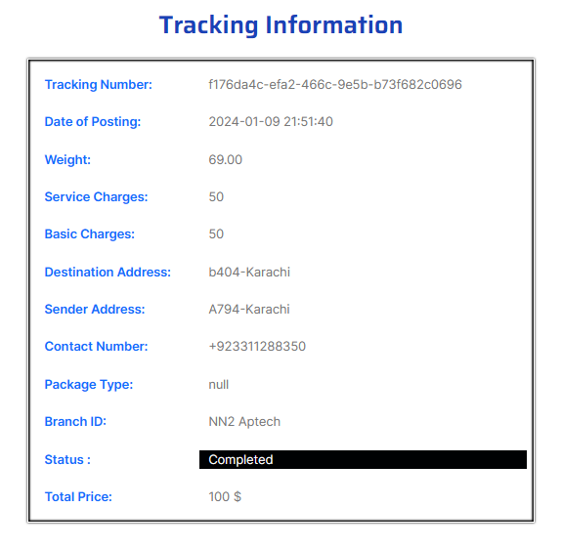
TRACKING
These are the delivery details that the user searches using the delivery ID.

Slide 7
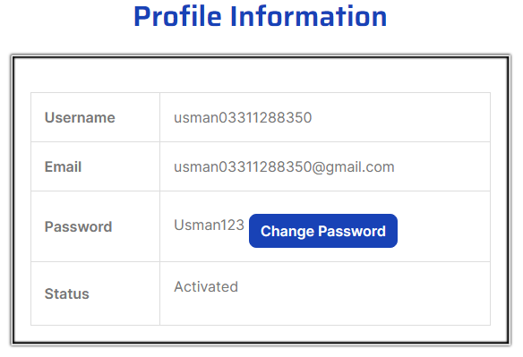
FORGET PASSWORD
These are the delivery details that the user searches using the delivery ID.

Slide 8
ADMIN FUNCTIONALITIES

Slide 9
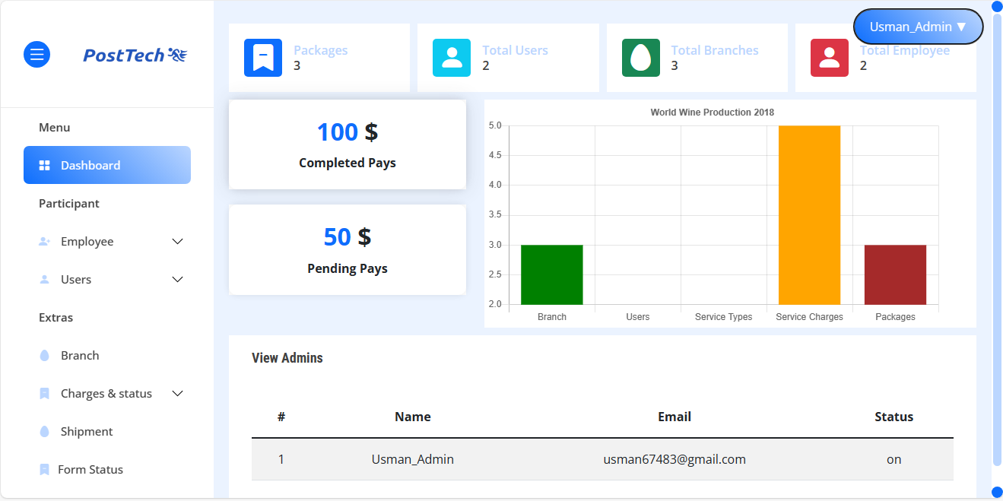
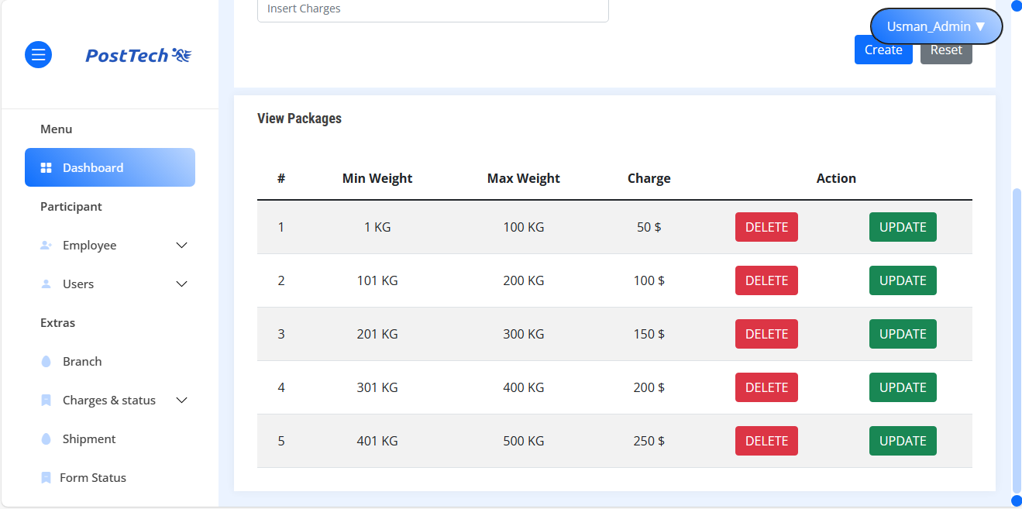
ADMIN DASHBOARD
In the admin dashboard, the administrator can create employees, update charges, add packages, and change the status of forms and the administrator can also view all the deliveries.

Slide 10
EMPLOYEE FUNCTIONALITIES

Slide 11
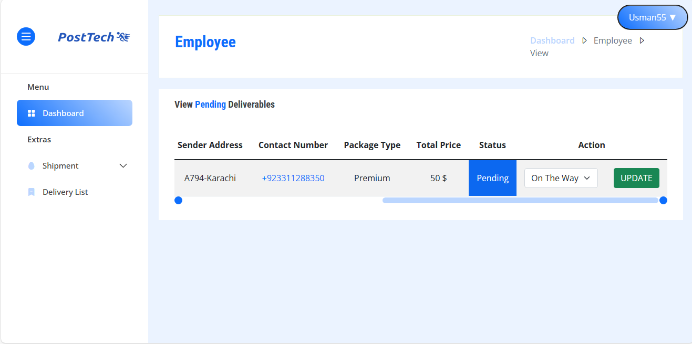
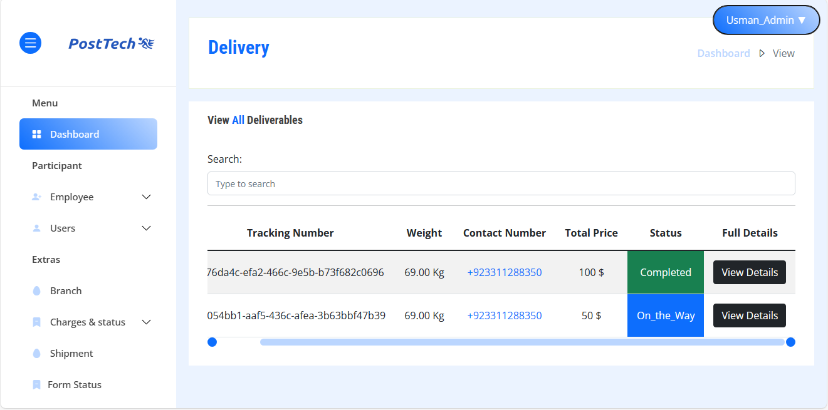
EMPLOYEE DASHBOARD
In the employee dashboard, employees manage the details of deliveries sent by users.

Slide 12
THANKS !!!

